Slide 1

Unpacking Walmart's Sales:
A Performance Insight
Narayan Aravind
Batch: 2024 (1st Year)
Branch: Electronics and Telecommunications
Roll: 2404042

Slide 2
Outline
Executive Summary
Project Description
Industry Context and Relevancy of Data
Objective Story
Challenges
Purpose of the Project
Business Impact
Methodology
Results
Data Visualization
PowerBi Dashboard
Analysis
Conclusion

Slide 3
Executive Summary
Regional Sales Trends
Store Performance Benchmarking
Inventory Benchmarking
Sales Forecasting and Seasonality
Impact of External Factors

Slide 4
Project Description
Industry context and Relevancy of data:
Retail businesses, especially large chains like Walmart, rely heavily on data-driven insights to maintain operational efficiency, optimize inventory, and maximize profitability. As one of the largest retailers in the world, Walmart has an expansive network of stores that serve diverse customer bases across different regions, each with its own unique set of demand patterns, economic conditions, and competitive landscapes.The dataset you're working with, which covers sales data across multiple Walmart locations, is highly relevant to both the retail industry and broader sectors such as supply chain management and consumer behavior analysis. The following reasons highlight the importance of analyzing Walmart's store sales:
Operational Efficiency: Walmart operates in a competitive retail market, where understanding sales trends by location can provide critical insights for managing supply chains, logistics, and regional demand.
Consumer Preferences: Sales data reflects customer preferences, allowing Walmart to fine-tune its inventory to local markets, thus optimizing stock levels and reducing costs.
Seasonal Trends and Promotions: The retail sector is often influenced by seasonality and promotional activities. Analyzing sales trends helps identify which times of year require special attention for inventory and staffing decisions.
Competitor Insights: Understanding how different locations perform can also help Walmart strategize against competitors at the local level, tweaking pricing, product selection, and marketing strategies.
This dataset is particularly valuable for understanding retail performance at scale and can help identify not only internal operational inefficiencies but also external challenges such as shifting customer demands or economic impacts.

Slide 5
Project Description
Objective Story:
Background
As a business owner managing multiple Walmart stores across America, you face numerous challenges related to sales performance. Each region exhibits unique consumer behavior due to local economic conditions, demographic factors, and competition from other retailers. While some stores perform exceptionally well, others underperform, and it's not always easy to pinpoint why.
To maintain Walmart’s competitive edge, you need a comprehensive analysis of sales data that identifies the following:
What products are driving sales in specific regions?
Which stores are consistently underperforming or overperforming?
How are seasonal fluctuations and promotions impacting sales trends across stores?
Are there specific external factors, such as local economic conditions or competitor presence, affecting sales?
How can you leverage this data to optimize operations, improve inventory management, and enhance marketing strategies?

Slide 6
Project Description
Challenges
The complexity of managing a vast network of stores comes with several challenges:
Regional Disparities: Not all stores are alike. Some stores are in high-income neighborhoods, while others are in regions with economic downturns. This variability requires tailored strategies for each location.
Inventory Management: Ensuring that each store has the right products in stock is a critical challenge. Overstocking leads to unnecessary costs, while understocking results in missed sales opportunities.
Seasonal Demand: Sales in certain regions may peak during holidays, while others might see spikes during different times of the year. Understanding these patterns is vital for effective resource allocation.
Competition & External Factors: Certain stores face stiffer competition from other local retailers or e-commerce. Additionally, economic conditions, such as employment rates or local market trends, can significantly influence consumer spending patterns.
Optimizing Marketing Efforts: You need to determine which marketing campaigns resonate with customers in specific regions and which do not, to better allocate advertising budgets and promotions.

Slide 7
Project Description
Purpose of the Project
This project aims to leverage historical sales data from Walmart stores to drive better decision-making at the corporate and store levels. By analyzing this dataset, the goal is to create actionable insights that can address the above challenges, focusing on the following areas:
Regional Sales Trends: Identifying which products or categories are performing well in certain regions and which are underperforming. This helps in tailoring inventory and promotional strategies to local market needs.
Store Performance Benchmarking: Understanding the performance of stores relative to each other allows you to benchmark success, uncover reasons for underperformance, and replicate the success factors of high-performing stores.
Inventory Optimization: By analyzing sales trends, you can make data-driven decisions regarding stock levels, reducing overstocking and stockouts, and optimizing the supply chain for each store.
Sales Forecasting & Seasonality: Creating predictive models for sales performance based on historical trends and seasonality to better prepare for upcoming demand spikes or slumps, ensuring the right resources and staff are allocated accordingly.
Impact of External Factors: By integrating external datasets like economic indicators or competitor pricing strategies, the analysis will help uncover the role of external factors on sales performance, allowing for more informed strategic planning.

Slide 8
Project Description
Business Impact
Through this analysis, you, as a business owner, will gain:
Enhanced Operational Efficiency: By identifying regional patterns, you can fine-tune operational aspects like staffing, product availability, and logistics.
Improved Customer Satisfaction: Ensuring the right products are available at the right time in the right stores improves the customer experience, driving loyalty and repeat business.
Cost Savings: Reducing inefficiencies in inventory management leads to substantial cost savings, both from reduced waste and better stock control.
Competitive Advantage: Understanding local competition and consumer preferences allows Walmart to stay ahead of its rivals, offering tailored services, products, and pricing that outmatch competitors.

Slide 9
Project Description
Conclusion
This project is designed to turn raw sales data into strategic insights that Walmart can use to optimize performance at both the store and corporate levels. With the right analytical tools, we will uncover patterns that not only explain current performance but also inform future decisions, allowing Walmart to thrive in an increasingly competitive retail landscape.

Slide 10
Methodology

Slide 11
Methodology
Data Gathering
Data Preprocessing
Data Exploration
Data Visualization

Slide 12
Data Gathering
The following datasets were collected:
Features.csv which contained data regarding store,temperature, fuel prices, CPI index, unemployment and holidays for given dates
Stores.csv which contained data regarding the store, store type and store size.
Test.csv which contains data about the store, departments and holidays for given dates.
Train.csv which contains data regarding store, department,weekly sales and holidays for given dates
Datasets was collected from Kaggle.com
https://www.kaggle.com/datasets/aslanahmedov/walmart-sales-forecast?select=features.csv

Slide 13
Results

Slide 14
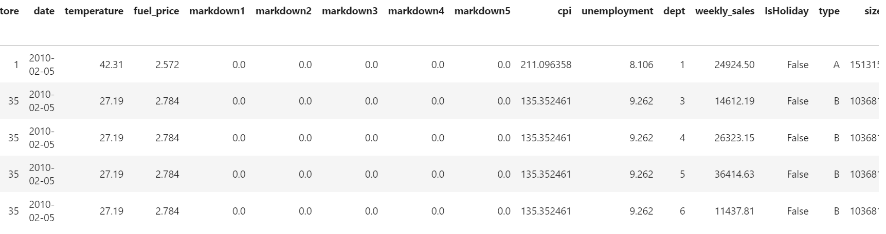
Data Visualization with Insights

Slide 15
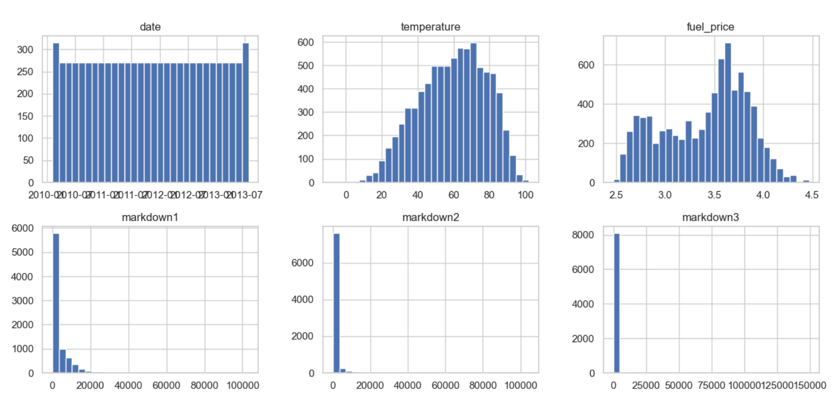
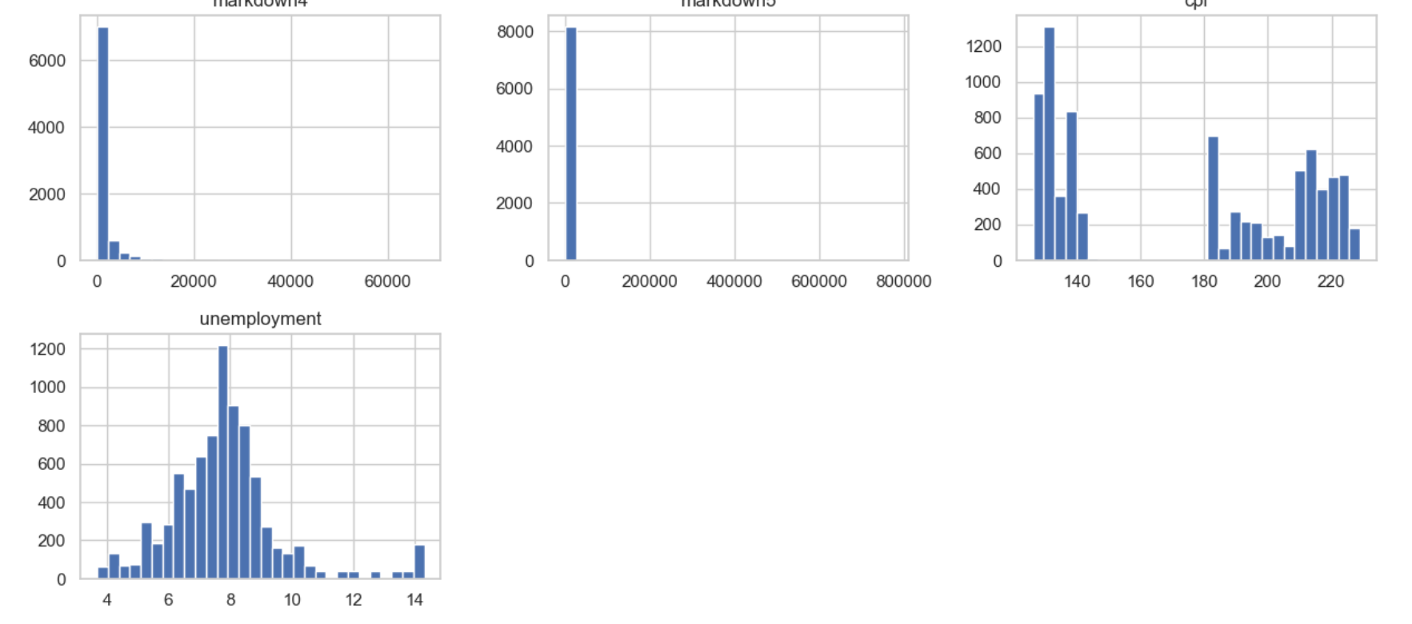
Histogram for Numeric Variables

Slide 16
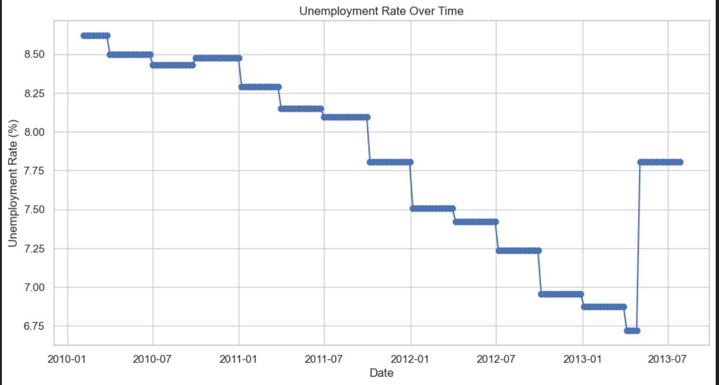
Unemployment Rate vs Time
Unemployment rate decreases over the years but increases in the 2013

Slide 17
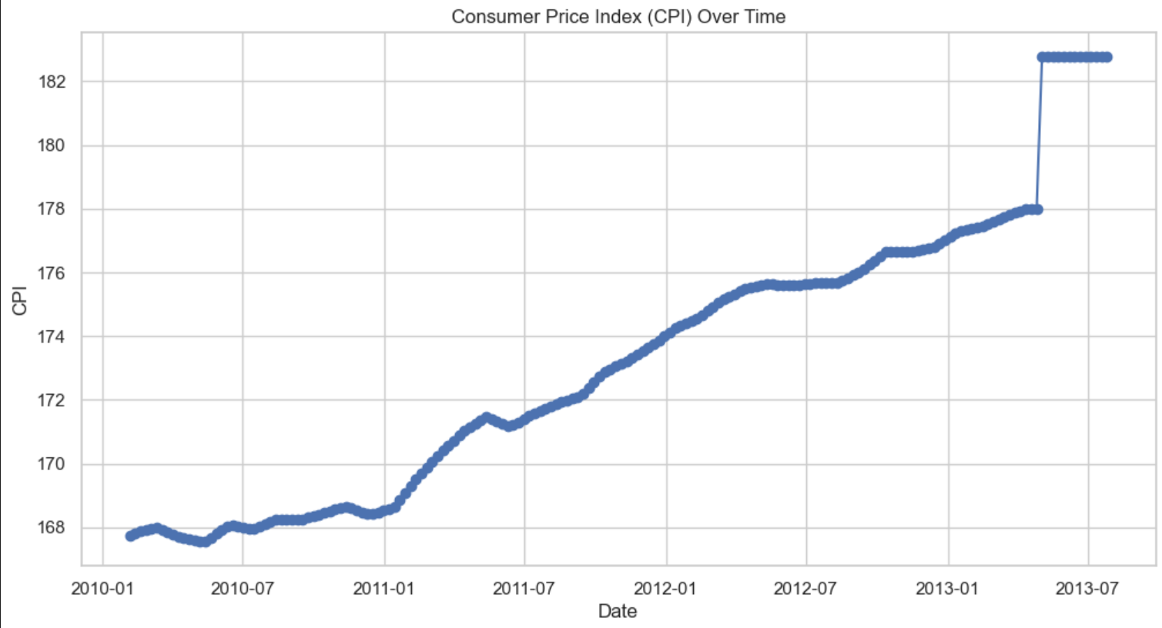
Consumer Price Index vs Time
Common Price Index increases over the given period of time.
This is sharp increase in 2013.

Slide 18
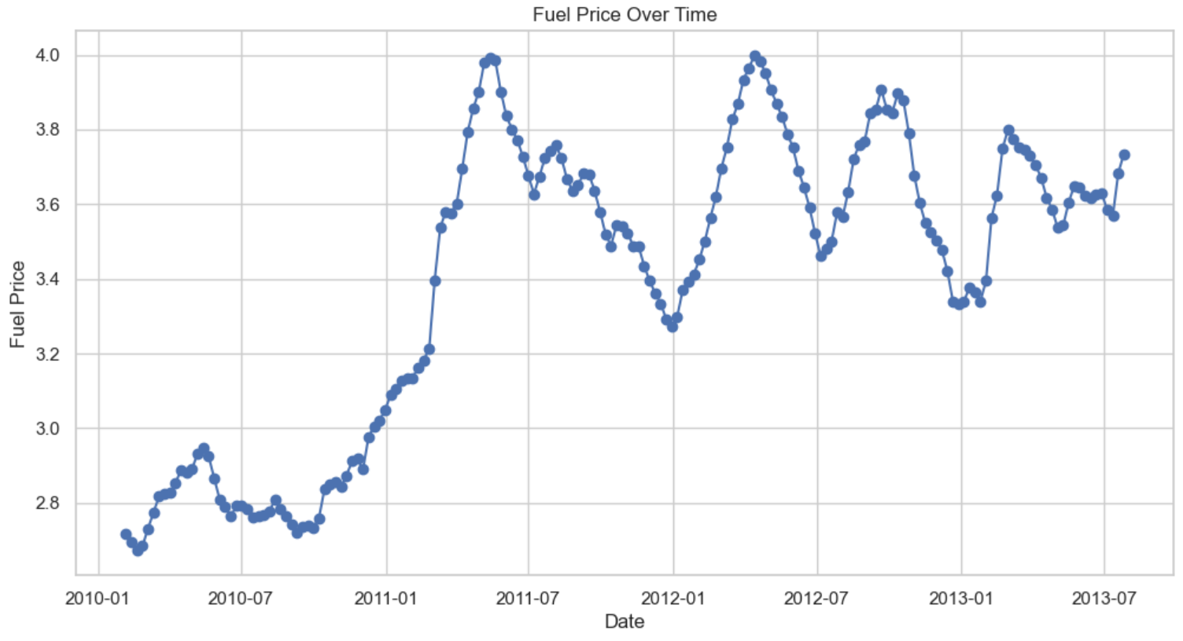
Fuel Price vs Time

Slide 19
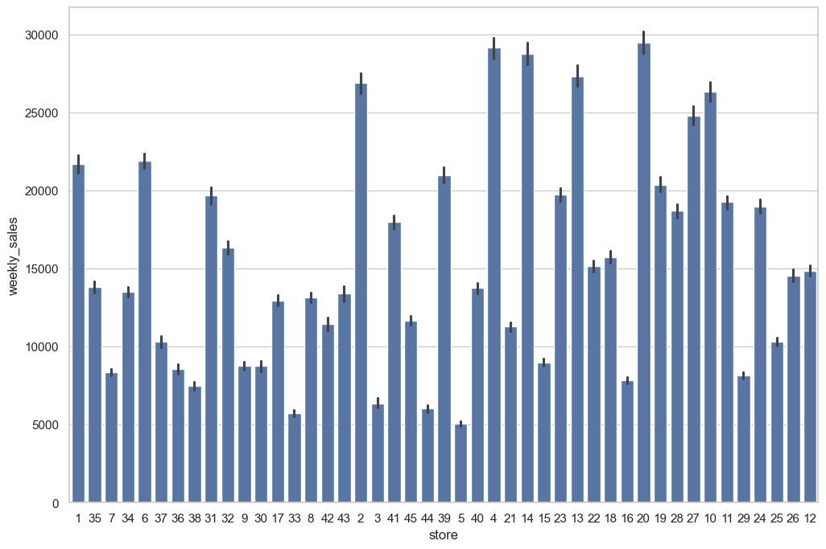
Weekly Sales in Different Stores
Highest weekly sales in store 20, followed by 4 and 14.

Slide 20
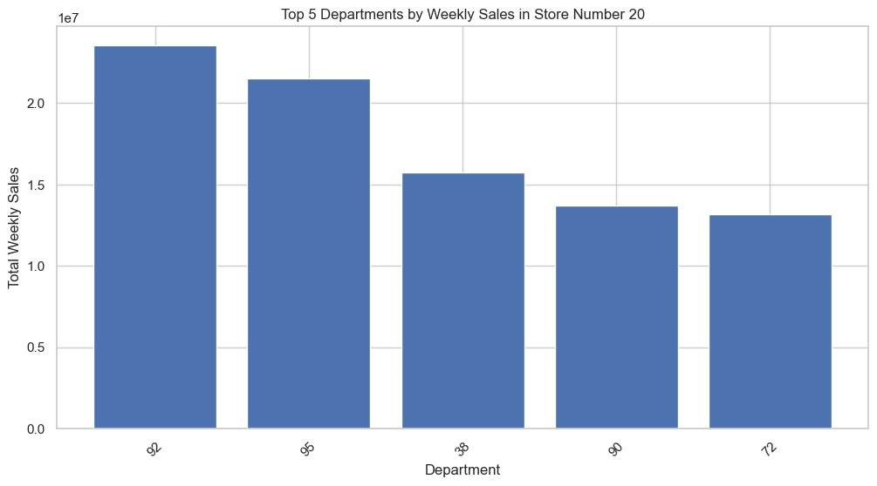
Top 5 Departments in Store 20
Department 92 sees highest weekly sales in store 20

Slide 21
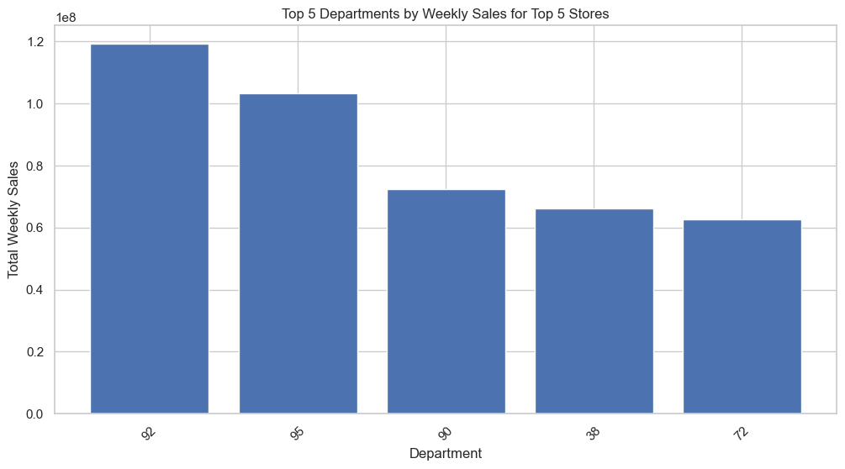
Top 5 Departments in all stores
Department 92 sees highest weekly sales

Slide 22
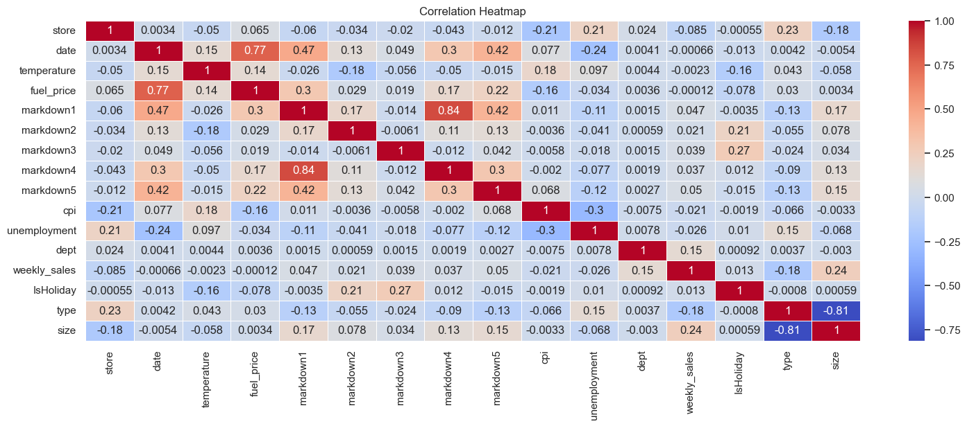
Correlation Heatmap

Slide 23
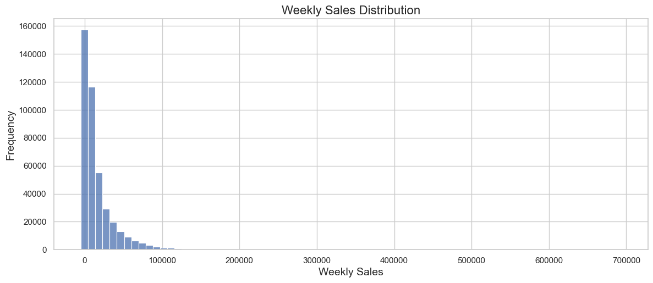
Weekly Sales Distribution
There are more days with low weekly sales than with high weekly sales

Slide 24
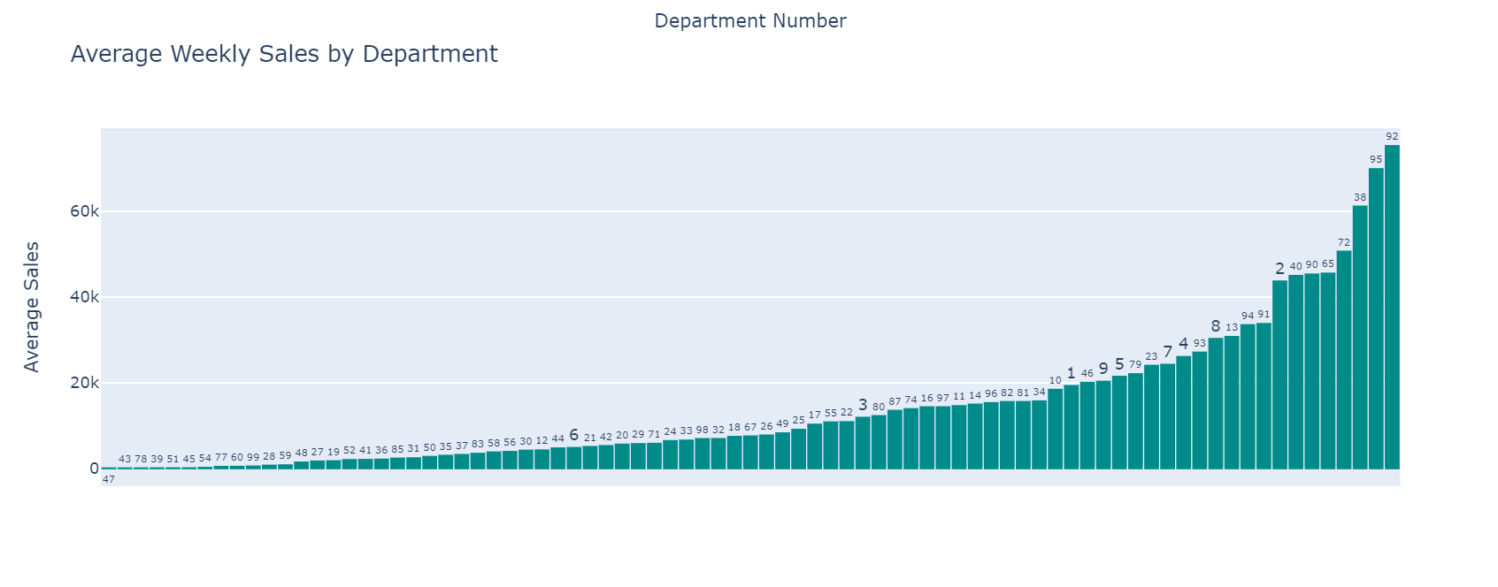
Average Weekly Sales by Department

Slide 25
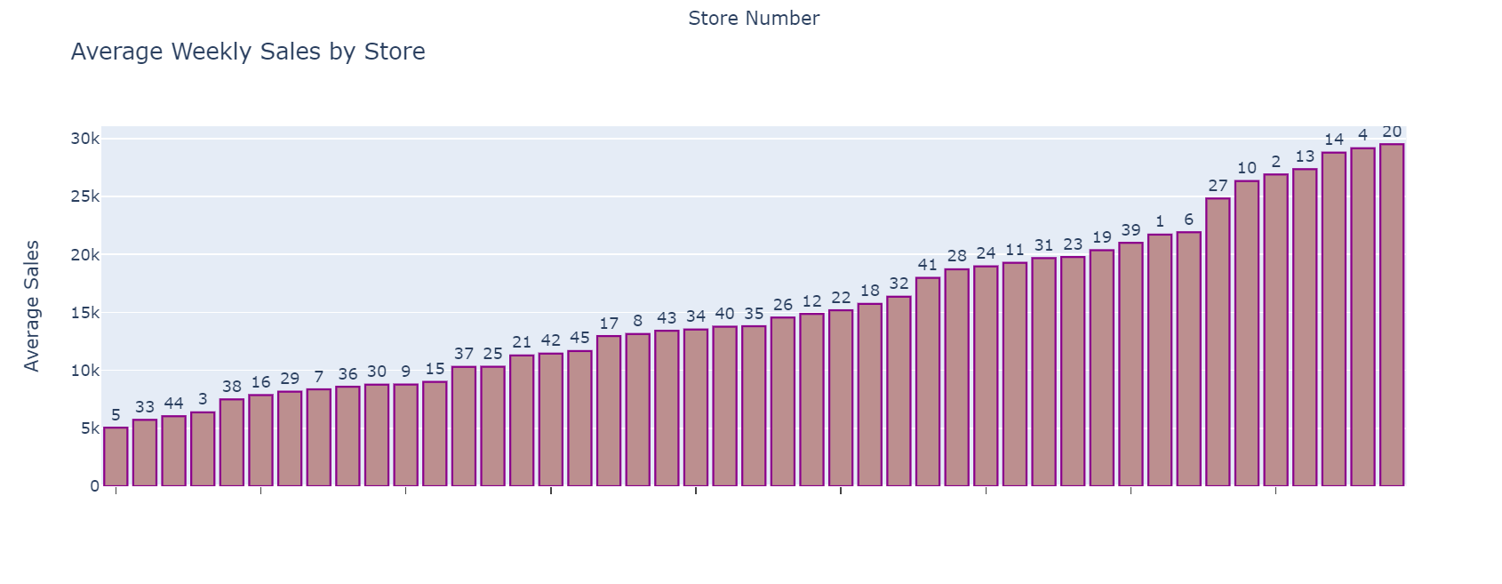
Average Weekly Sales by Store

Slide 26
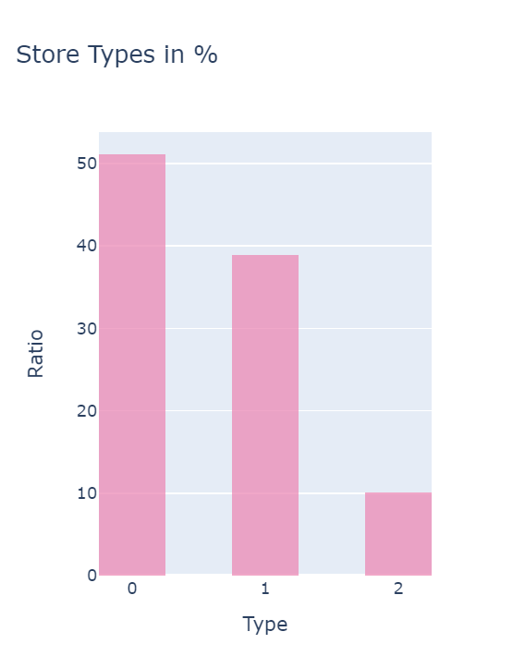
Percentage of Stores based on Type
There is a higher percentage of stores of type 0 and lowest percentage of type 2

Slide 27
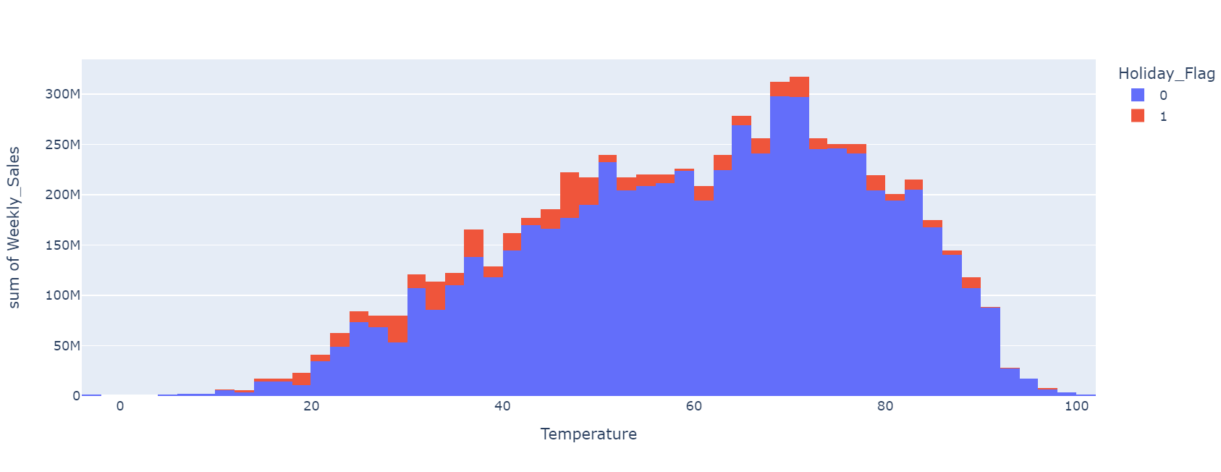
Weekly Sales vs Temperature

Slide 28
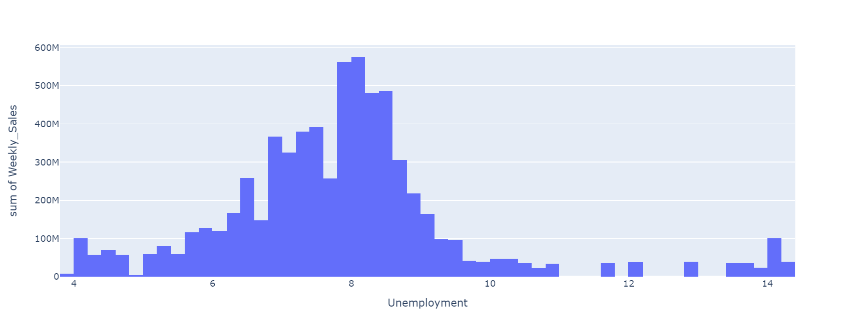
Weekly Sales vs Unemployment

Slide 29
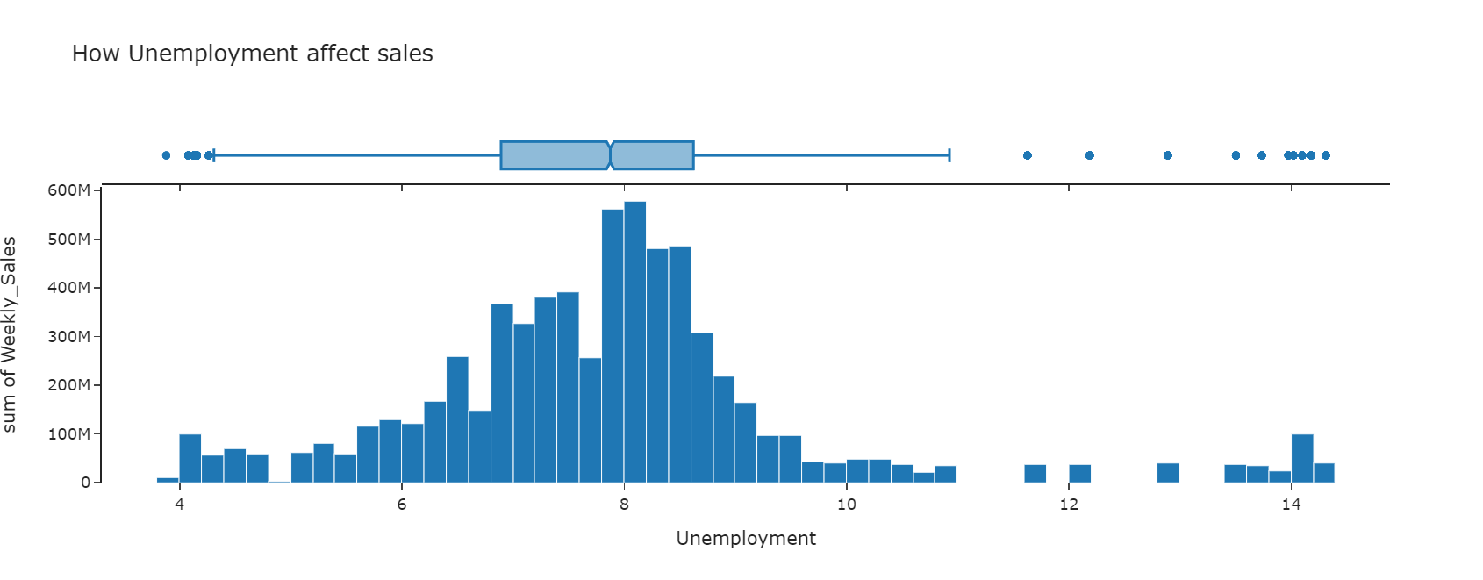
Unemployment vs Weekly Sales

Slide 30
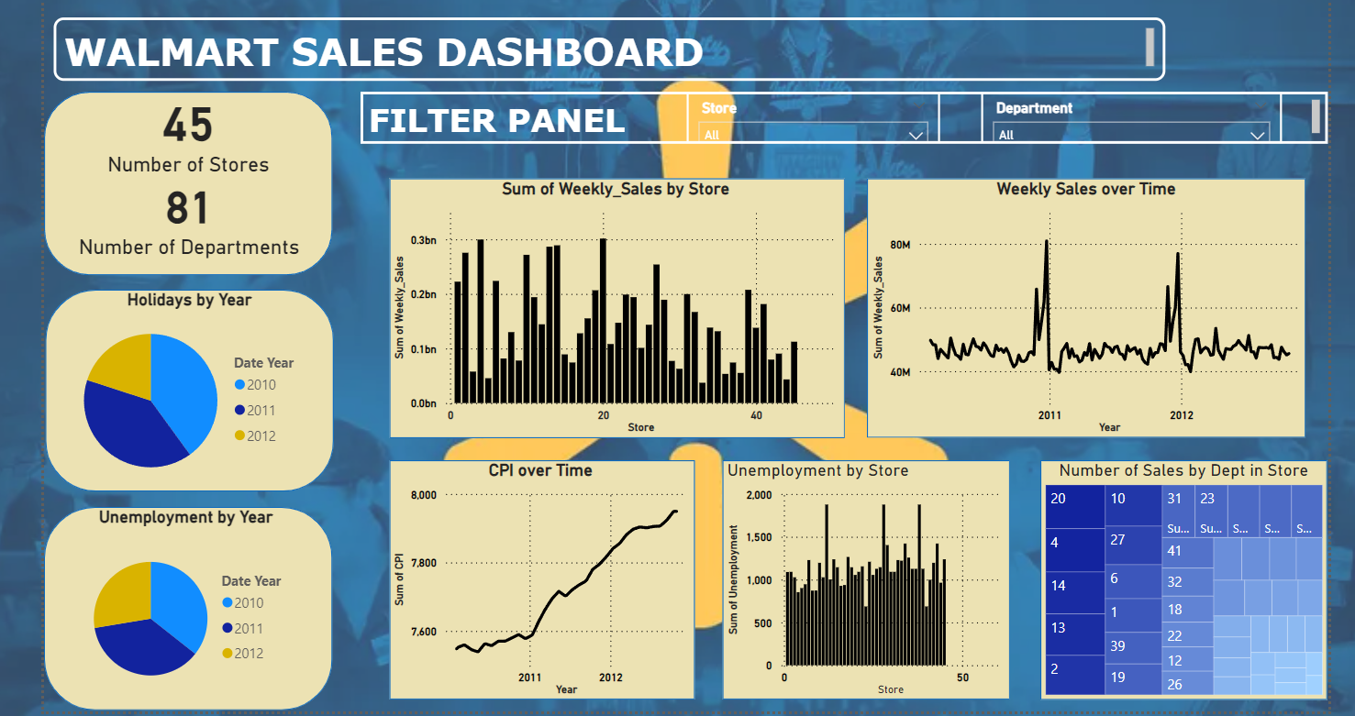
PowerBI Dashboard

Slide 31
Analysis

Slide 32
Key Performance Indicators
Total weekly sales
Average weekly sales
Unemployment rate
Consumer price index
Fuel price
Store and department
Temperature
Holidays

Slide 33
Business Questions to Address
Which store records highest average weekly sales?
According to the data, we see store 20 sees the highest average weekly sales. This helps us understand regional performance and disparities, and helps in tailoring market strategies and resource allocation
What external factors influences sales performance?
The most influential factors affecting sales performance are fuel price and temperature. This data helps in forecasting and making strategies accordingly.

Slide 34
Business Questions to Address
3. Which department sees highest sales?
Department 92 sees highest sales. Helps to identify trending and declining products, inform inventory and marketing decision.
4. How does Consumer Price Index affect sales?
The average weekly sales increases with increase in Consumer price Index.
5. Do factors like unemployment affect sales?
Yes factors like unemployment affects sales.

Slide 35
Business Questions to Answers
6. Which store is most sensitive to economic factors such as CPI and unemployment?
Store 12 is most sensitive to economic factors.
7. Are certain months or seasons associated with higher sales?
Yes, as the sales depends on festive season, fuel price, CPI Index, etc.
8. What is the impact of fuel prices on holiday week sales compared to non-holiday weeks?
Fuel prices affect holiday week sales more than non-holiday week sales

Slide 36
Business Questions to Answers
9. What is the trend in sales over time across all stores?
According the date, we can see the average weekly sales gradually increase over the years across all stores.
10. Can we predict future sales based on historical sales, economic indicators (CPI, unemployment), and fuel prices?
Yes, by analysis the data, understanding the sales trends with respect to economic indicators and other factors, we can predict future sales, and make strategies to improve future sales.

Slide 37
Conclusion
Analysis of trends in weekly sales over a period of time across different departments and stores.
Studying the influence of economic factors like CPI Index and unemployment and external factors like holidays, temperature and fuel price on sales.
Actions to be taken.

Slide 38


